Slide 1

Understanding the Business Value of Systems and Managing Change
Chapter 14

Slide 2
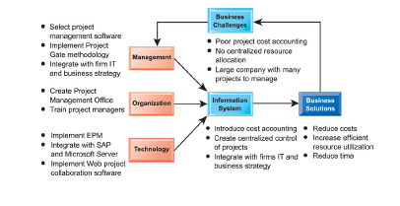

Slide 3
Objectives
How can our company measure the business benefits of our information systems? What models should be used to measure that business value?
Why do so many system projects fail? What are the principal reasons for system failures?
How should the organizational change surrounding a new system be managed to ensure success?

Slide 4
Objectives
Are there any special challenges to implementing international information systems?
What strategies can an organization use to manage the system implementation process more effectively?

Slide 5
Management Challenges
Determining benefits and costs of a system when they are difficult to quantify.
Dealing with the complexity of large-scale systems projects.

Slide 6
Understanding the Business Value of Information Systems
Two Kinds of Information System Investments
System Projects
Infrastructure

Slide 7
Understanding the Business Value of Information Systems
IT Investment Values
Improvement in business processes
Improvement in management decision making
Longer Term Values
Improve strategic position
Implement new technologies and products

Slide 8
Understanding the Business Value of Information Systems
Traditional Capital Budgeting Models
Capital Budgeting
Rely on measuring cash inflows and outflows
6 capital budgeting models
    Payback method
    Accounting rate of return on investment (ROI)
    Net present value
    Cost-benefit ratio
    Profitability index
    Internal rate of return (IRR)

Slide 9
Understanding the Business Value of Information Systems
Traditional Capital Budgeting Models
Costs and Benefits of Information Systems
Costs:
    Hardware, telecommunications, software, services, personnel
Tangible benefits (cost savings):
    Increased productivity, lower operational costs, reduced workforce, etc.
Intangible benefits:
    Improved asset utilization, improved resource control, improved organizational planning, etc.

Slide 10
Understanding the Business Value of Information Systems
Traditional Capital Budgeting Models
Limitations of Financial Models
Costs and benefits don’t occur in same time frame
Difficulties in measuring intangible benefits
Bias toward applications with specific business functions
Overlook social and organizational costs and benefits

Slide 11
Understanding the Business Value of Information Systems
Case Example: Capital Budgeting for a New Supply Chain Management System
Heartland Stores
General merchandise retail chain upgrading supply chain management system
Reduce inventory costs: Items stocked in inventory
Reduce labor costs: Inventory and tracking personnel
Reduce telecommunication costs: Less time on phone tracking inventory and shipments
Reduce transportation costs: Consolidating shipments, more efficient shipping schedules

Slide 12
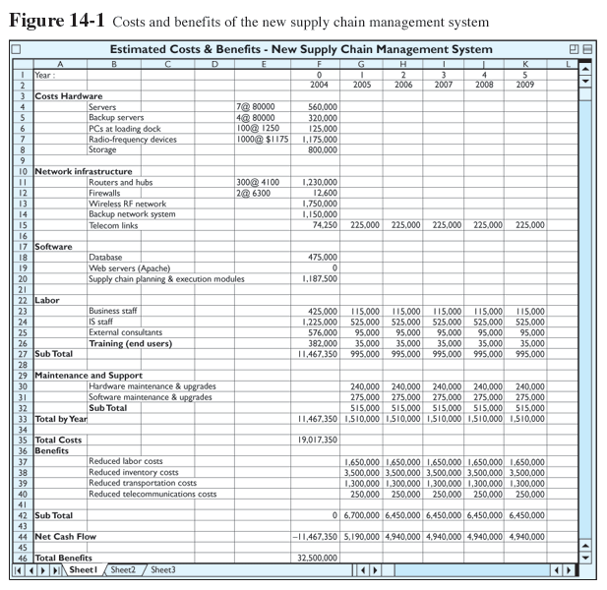
Understanding the Business Value of Information Systems
Costs and benefits of the new supply chain management system
Figure 14-1

Slide 13
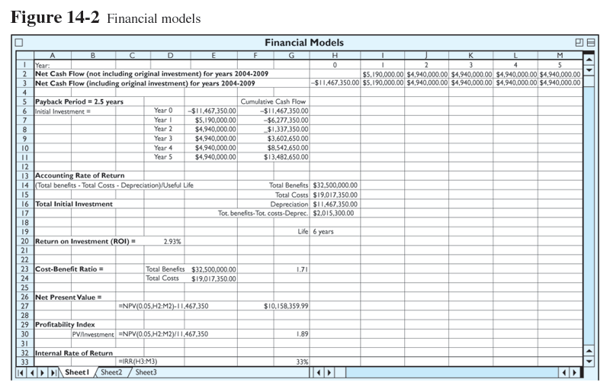
Understanding the Business Value of Information Systems
Financial models
Figure 14-2

Slide 14
Understanding the Business Value of Information Systems
Case Example: Capital Budgeting for a New Supply Chain Management System
Payback Method
Time required to pay back initial investment of project
Original investment | = | Number of years to pay back
Annual net cash inflow

Slide 15
Understanding the Business Value of Information Systems
Case Example: Capital Budgeting for a New Supply Chain Management System
Accounting Rate of Return on Investment (ROI)
Desired rate of return must equal or exceed cost of capital
(Total benefits – Total cost – Depreciation) | = | Net benefit
Useful life
Net benefit | = | ROI
Total initial investment

Slide 16
Understanding the Business Value of Information Systems
Case Example: Capital Budgeting for a New Supply Chain Management System
Net Present Value
Compare investment with future savings and earnings
Present value of expected cash flows | - | Initial investment cost | = | Net present value

Slide 17
Understanding the Business Value of Information Systems
Case Example: Capital Budgeting for a New Supply Chain Management System
Cost-Benefit Ratio
Ratio of benefits to cost
Total benefits | = | Cost-benefit ratio
Total costs

Slide 18
Understanding the Business Value of Information Systems
Case Example: Capital Budgeting for a New Supply Chain Management System
Profitability Index
Allows ranking of different possible investments
Present value of cash inflows | = | Profitability index
Investment

Slide 19
Understanding the Business Value of Information Systems
Case Example: Capital Budgeting for a New Supply Chain Management System
Internal Rate of Return (IRR)
Rate of return, or profit, that an investment is expected to earn
Discount (interest) rate that will equate the present value of the projects future cash flows to the initial investment cost

Slide 20
Understanding the Business Value of Information Systems
Strategic Considerations
  Portfolio Analysis
  Analysis of portfolio of potential applications to determine risks and benefits, and select among alternatives
  Scoring Models
  Method for deciding among alternative systems based on a system of ratings

Slide 21
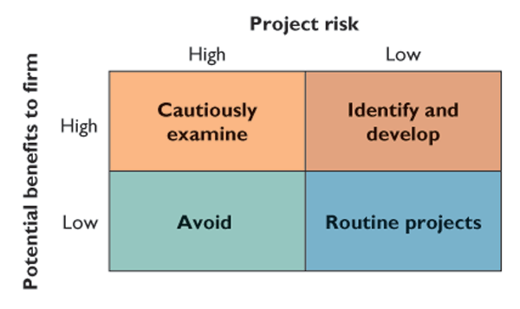
Understanding the Business Value of Information Systems
A system portfolio
Figure 14-3

Slide 22
Understanding the Business Value of Information Systems
Strategic Considerations
Real Options Pricing Models
Models using techniques for valuing financial options to evaluate information technology investments with uncertain returns
Knowledge Value–Added Approach
Focuses on knowledge input into a business process
Determines costs and benefits of changes in business processes from new information systems

Slide 23
Understanding the Business Value of Information Systems
Information Technology Investments and Productivity
Multi-Factor Productivity
Measure of firm’s efficiency in converting inputs to outputs
Amount of capital and labor required to produce a unit of output
“Productivity Paradox”

Slide 24
Understanding the Business Value of Information Systems
Information Technology Investments and Productivity
Information Technology Contributions
Manufacturing: Increased productivity
Service sector: Benefits unclear
Information and knowledge industries: Benefits difficult to measure

Slide 25
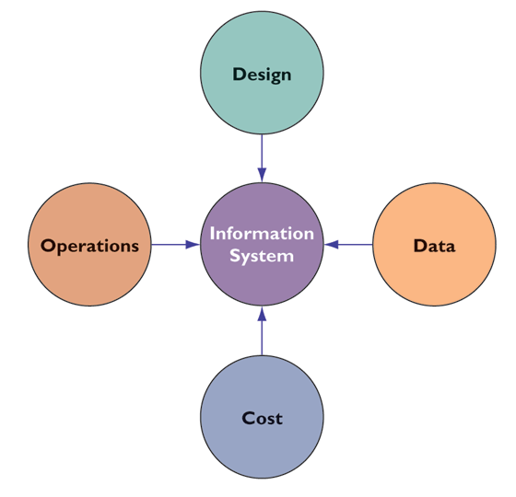
The Importance of Change Management in
Information System Success and Failure
Information system problem areas
Figure 14-4

Slide 26
The Importance of Change Management in
Information System Success and Failure
Information System Problem Areas
Design
    Failure to capture essential business requirements
    Information in difficult to use format; poor user interface
    Incompatible with organization structure, culture, goals

Slide 27
The Importance of Change Management in
Information System Success and Failure
Information System Problem Areas
Data
    Inaccuracy, inconsistency of data
    Not organized properly for business purposes
Cost
    Cost to implement and run prohibitive
Operations
    Computer operations breaking down
    Information delays, slow response times

Slide 28
The Importance of Change Management in
Information System Success and Failure
Change Management and the Concept of Implementation
Implementation
    All organizational activities working toward the adoption, management, and routinization of an innovation
Change Agent
    Individual acting as catalyst during the change process

Slide 29
The Importance of Change Management in
Information System Success and Failure
Causes of Implementation Success and Failure
User Involvement and Influence
    Molding system to user priorities and business requirements
    Positive involvement in system
    Users can take limited view of system
    User-designer communications gap

Slide 30
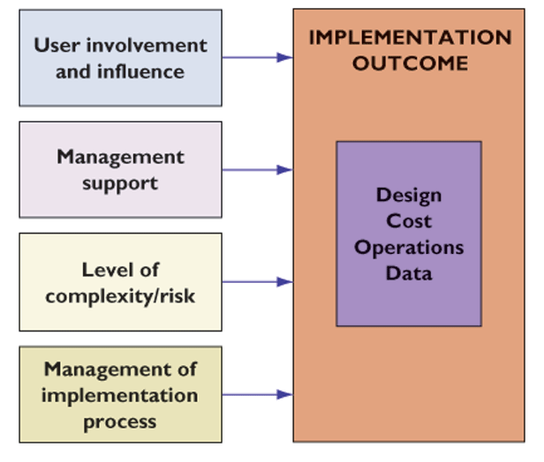
The Importance of Change Management in
Information System Success and Failure
Factors in information system success or failure
Figure 14-5

Slide 31
The Importance of Change Management in
Information System Success and Failure
Causes of Implementation Success and Failure
Management Support and Commitment
    Positive perception
    Inducement to participation
    Sufficient funding and resources
    Enforcement of workflow changes

Slide 32
The Importance of Change Management in
Information System Success and Failure
Causes of Implementation Success and Failure
Level of Complexity and Risk
    Project size: Greater risk with larger projects
    Project structure: Greater risk with less defined outputs and processes
    Experience with technology: Greater risk if project team and information systems staff lack required expertise

Slide 33
The Importance of Change Management in
Information System Success and Failure
Causes of Implementation Success and Failure
Results of Poorly Managed Systems Projects
Costs that vastly exceed budgets
Unexpected time slippage
Technical shortfall; poor performance
Failure to obtain anticipated benefits

Slide 34
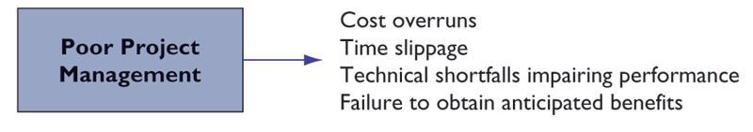
The Importance of Change Management in
Information System Success and Failure
Consequences of poor project management
Figure 14-6

Slide 35
The Importance of Change Management in
Information System Success and Failure
Causes of Implementation Success and Failure
Factors in Poor Management:
Ignorance and optimism
The mythical man-month
    When adding labor can slow productivity
Falling behind
    Bad news travels slowly upward

Slide 36
The Importance of Change Management in
Information System Success and Failure
Change Management Challenges for Business Process Reengineering (BPR)
Enterprise Applications, and Mergers and Acquisitions
70% failure rate in BPR projects
High failure rate in enterprise applications
Poor implementation; inadequate change management
M&As: Require considerable organizational change and system projects to combine information systems of two companies

Slide 37
The Importance of Change Management in
Information System Success and Failure
The Challenge of Implementing Global Systems
Disparate information requirements and business processes
    Local facility differences
    National accounting laws
    Transborder data flow
    Language

Slide 38
The Importance of Change Management in
Information System Success and Failure
The Challenge of Implementing Global Systems
Technology hurdles: lack of standards and connectivity
    Standardizing computer hardware platform
    Software for international teamwork
    Integrated global networks difficult, costly to install
    Standards for networking and EDI are industry and country specific
Local user resistance to global systems

Slide 39
The Importance of Change Management in
Information System Success and Failure
Window on Organizations
Global E-Commerce: Good and Bad News
What management, organization, and technology issues should be addressed when developing a global Web strategy?

Slide 40
Managing Implementation
Controlling Risk Factors
Managing technical complexity
    Internal integration tools
Formal planning and control tools
    Program Evaluation and Review Technique (PERT)
    Gantt charts
Increasing user involvement and overcoming user resistance
    External integration tools
    User participation, education and training, incentives

Slide 41
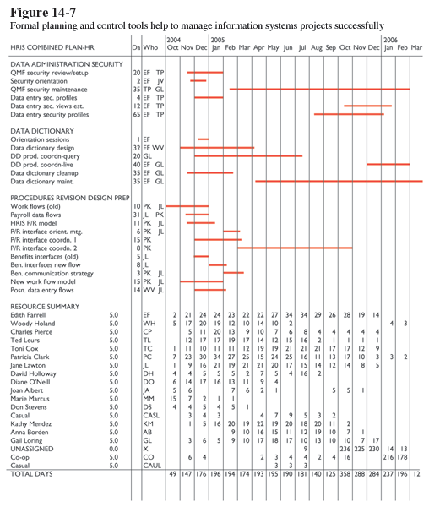
Managing Implementation
Formal planning and control tools help to
manage information systems projects successfully
Figure 14-7

Slide 42
Managing Implementation
Designing for the Organization
Organizational Factors in Systems Planning and Implementation
Employee participation and involvement
Job design
Standards and performance monitoring
Ergonomics
Employee grievance resolution procedures
Health and safety
Government regulatory compliance

Slide 43
Managing Implementation
Designing for the Organization
Organizational impact analysis
    Study of how a proposed system will affect the organization structure, attitudes, decision making, and operations
Sociotechnical design
    Establishes human objectives
    Separate sets of technical and social design solutions
    Design based on best fit to technical and social needs

Slide 44
Managing Implementation
Managing Global Implementations
Limit transnational development to core systems
Cooptation
    Bringing opposition into development process
Separate transnational systems developed by separate country units
Global technology infrastructure
    International private network, VANs
    Internet technology: VPNs, intranets

Slide 45
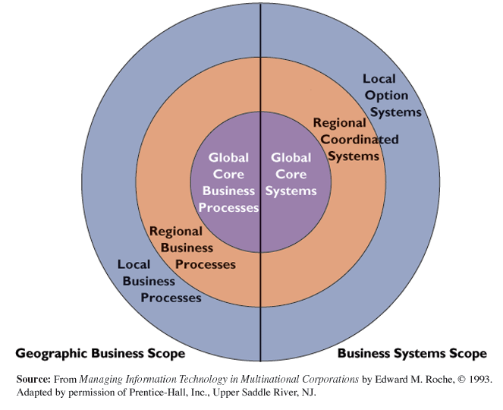
Managing Implementation
Local, regional, and global systems
Figure 14-8

Slide 46
Managing Implementation
“Fourth Generation” Project Management
Project planning as an enterprise-wide focus
Managers focus on solving problems as they arise and meeting challenges
Seek ways to adapt to unforeseen uncertainties that could provide additional opportunities

Slide 47
Chapter 14 Case Study
Cigna Stumbles with a New Customer Service System
Evaluate Cigna using the value chain and competitive forces models. What was Cigna’s business strategy?
What was the relationship of its information systems to Cigna’s business systems and business strategy? How well did its systems support its strategy? How did they provide value for the company?
What management, organization, and technology factors contributed to Cigna’s problems?

Slide 48
Chapter 14 Case Study
Cigna Stumbles with a New Customer Service System
Classify and describe the problems that Cigna faced in trying to modernize its customer-facing systems using the categories described in this chapter on the causes of system failure.
Evaluate the risks of the Cigna systems modernization project as seen at its outset, and then outline its key risk factors. Describe the steps you would have taken during the planning stage of the project to control these factors.

